Slide 1
Q1
Sort-Merge Join using Z-values

Slide 2
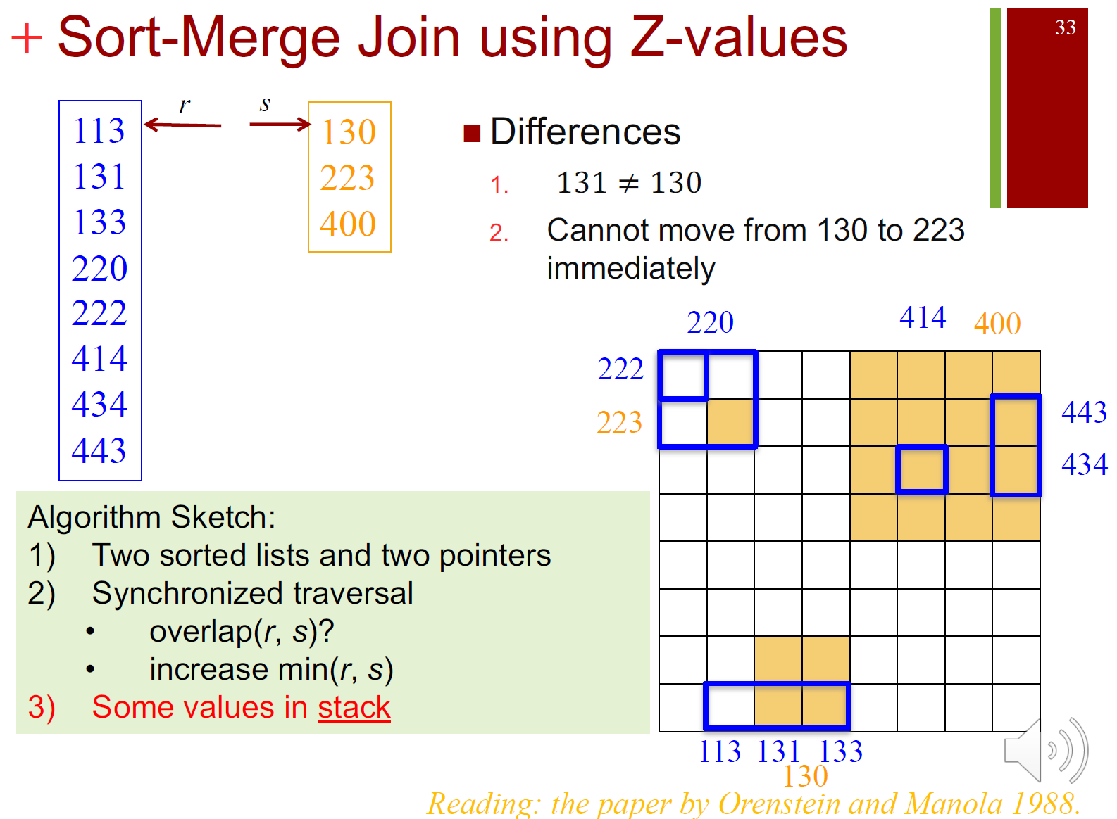

Slide 3
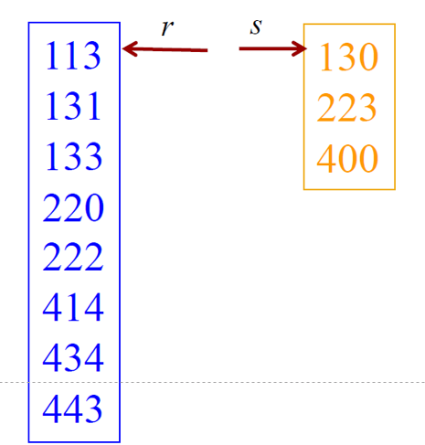
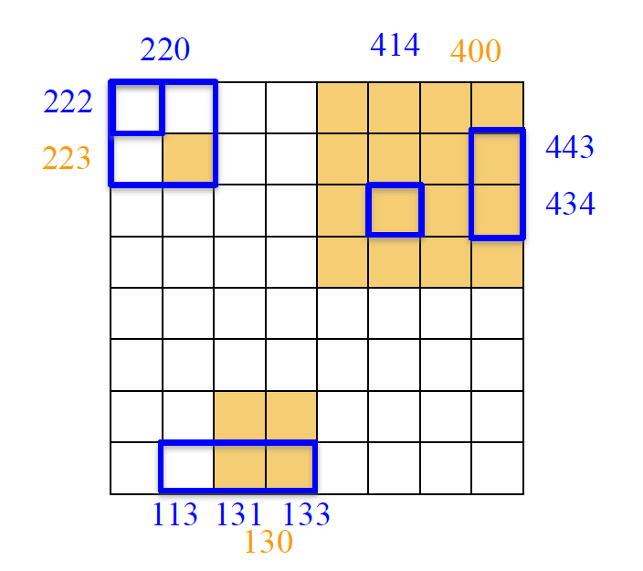
Step 1:
Take 113 and 130, because 13 and 30 do not intersect, we skip this pair.
Because 113 is smaller than 130, and 130 is at a higher level, we visit the next value in r.
C = {}

Slide 4

Step 2:
Take 131 and 130, because 30 covers 31, we add (131, 130) into the candidate list. Because 131 is larger than 130, we visit the next value in s. Meanwhile, because 130 is at a higher level, we have to keep 130 in stack (do not remove it from the comparison list).
C = {(131,130)} S = {130}

Slide 5
Step 3:
Take 131 and 223, they do not intersect, and 223 is larger than 133, we visit the next value in r.
C = {(131,130)} S = {130}

Slide 6
Step 4:
Take 133 and 130, because 30 covers 33, we add (133, 130) into the candidate list.
Take 133 and 223, they do not intersect. Because 133 is smaller than 223, we visit the next value in r.
C = {(131,130), (133, 130) } S = {130}

Slide 7
Step 5:
Take 220 and 130, they are totally different, and 130 is smaller than 220, they are at the same level, so it is guaranteed that no value in R will intersect with 130. Therefore, we remove 130 out of stack. Next, we compare 220 and 223, because 220 covers 223, we add (220, 223) into C. 220 is at a higher level than 223, we put 220 into stack, and we visit next value in r.
C = {(131,130), (133, 130), (220, 223) } S = {220}

Slide 8
Step 6:
Take 222 and 223, they do not overlap, and we visit the next value in r.
C = {(131,130), (133, 130), (220, 223) } S = {220}

Slide 9
Step 7:
414 and 223, they do not intersect, and 414 is larger than 223, we visit the next value in s.
C = {(131,130), (133, 130), (220, 223) } S = {220}

Slide 10
Step 8:
Take 220 and 400, they do not intersect, we move 220 out of stack.
Take 414 and 400, 414 is covered by 400, so we put (414, 400) into the candidate list. 400 is the last value of R, and it is at a higher level, so we put 400 into the stack, and visit the next value in r.
C = {(131,130), (133, 130), (220, 223), (414, 400) } S = {400}

Slide 11
Step 9:
Take 434 and 400, 434 is covered by 400, so we add (434, 400) into the candidate list, and we visit the next value in r.
C = {(131,130), (133, 130), (220, 223), (414, 400), (434, 400)}
S = {400}

Slide 12
Step 10:
443 is covered by 400, so we add (443, 400) into the candidate list, and the merge finishes.
C = {(131,130), (133, 130), (220, 223), (414, 400), (434, 400), (443, 400)}
S = {400}

Slide 13
C = {(131,130), (133, 130), (220, 223), (414, 400), (434, 400), (443, 400)}
We might do some housekeep check because some of the testing pairs are duplicated, like (131,130) and (133,130). Both 131 and 133 points to the same object, so we only need to retrieve and test the actual intersection once.

Slide 14
Q2
Spatial Hash Join: When we do the hash based spatial join, we have two choices of hash functions: single assignment and multiple assignment, and two join procedures: single join and multiple join. Different index would require different join procedure. Please discuss which kind of join procedure should be used by R-Tree, Z-order, and R+-Tree, and explain why.

Slide 15
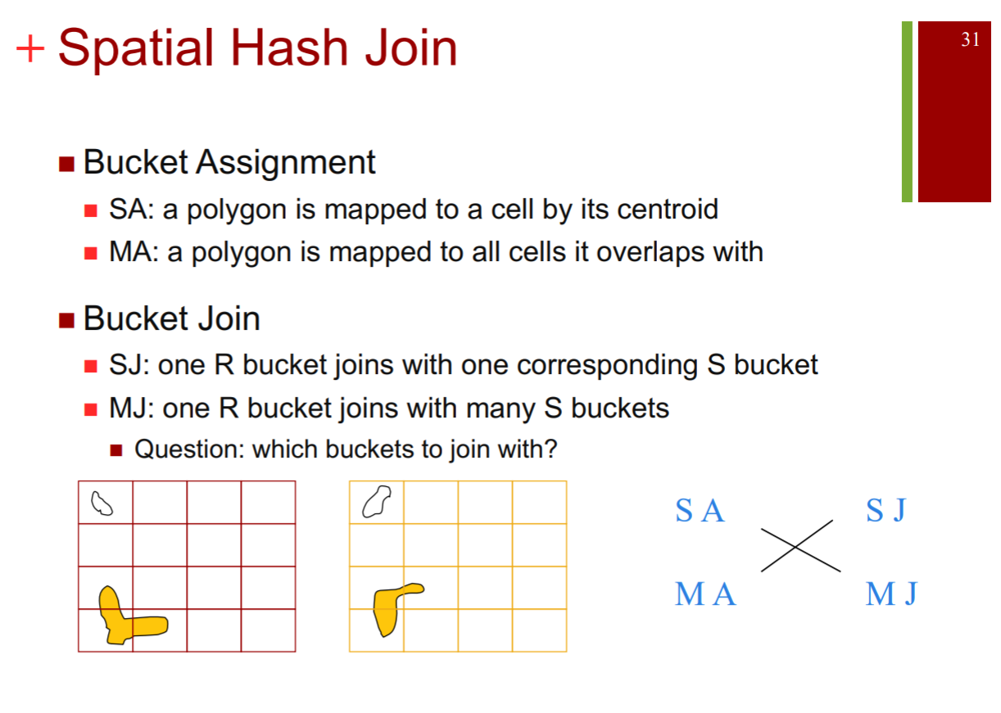

Slide 16
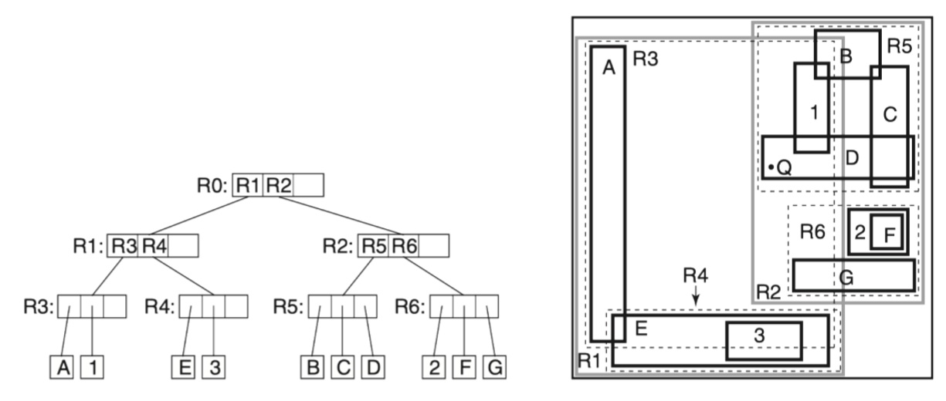
R tree
each object is enclosed by only one MBR, so it belongs to the single assignment. When we use the single assignment hash function, we have to run the multiple join procedure to guarantee the correctness. Therefore, to get the result, we have to join all the intersected objects together.

Slide 17
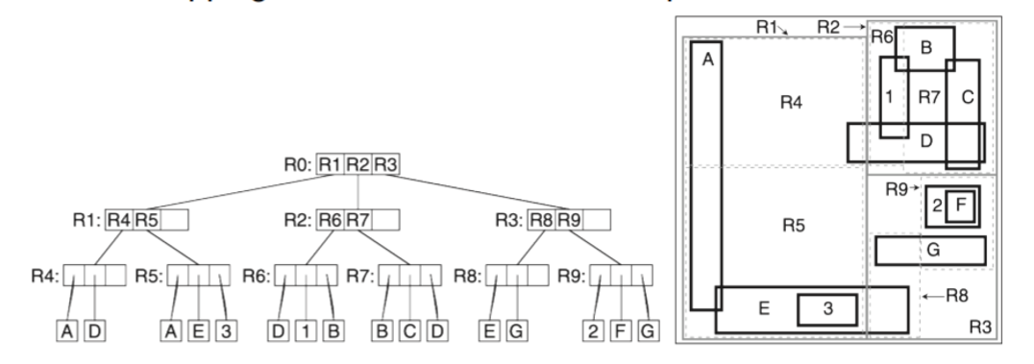
R+ tree
one polygon can exist in several MBRs, so it belongs to the multiple assignment. When we use the multiple assignment hash function, we only need to join once for each object to obtain the result. (single join)

Slide 18
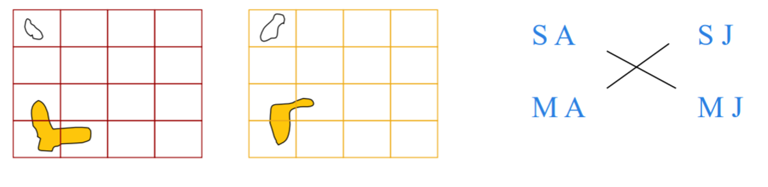
Z-order
For Z-order, one polygon can exist in several cells, so it belongs to the multiple assignment. When we use the multiple assignment hash function, one cell joins with one corresponding cell. (single join)

Slide 19
Q3
R tree NN search: When using the R-tree to search for the nearest neighbor, we have two metrics to determine the search order: MINDIST and MINMAXDIST. The MINDIST is the optimistic choice, while the MINMAXDIST is the pessimistic one. Is the MINDIST always a better ordering than using the MINMAXDIST?

Slide 20
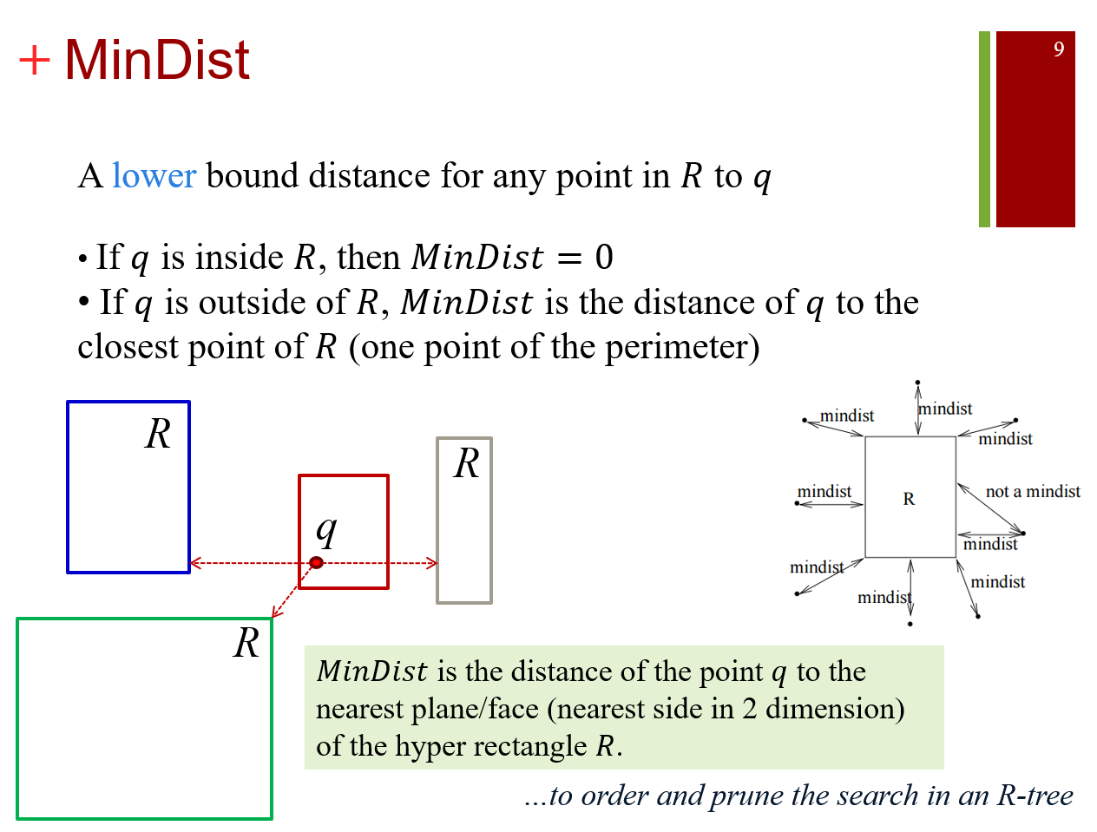

Slide 21
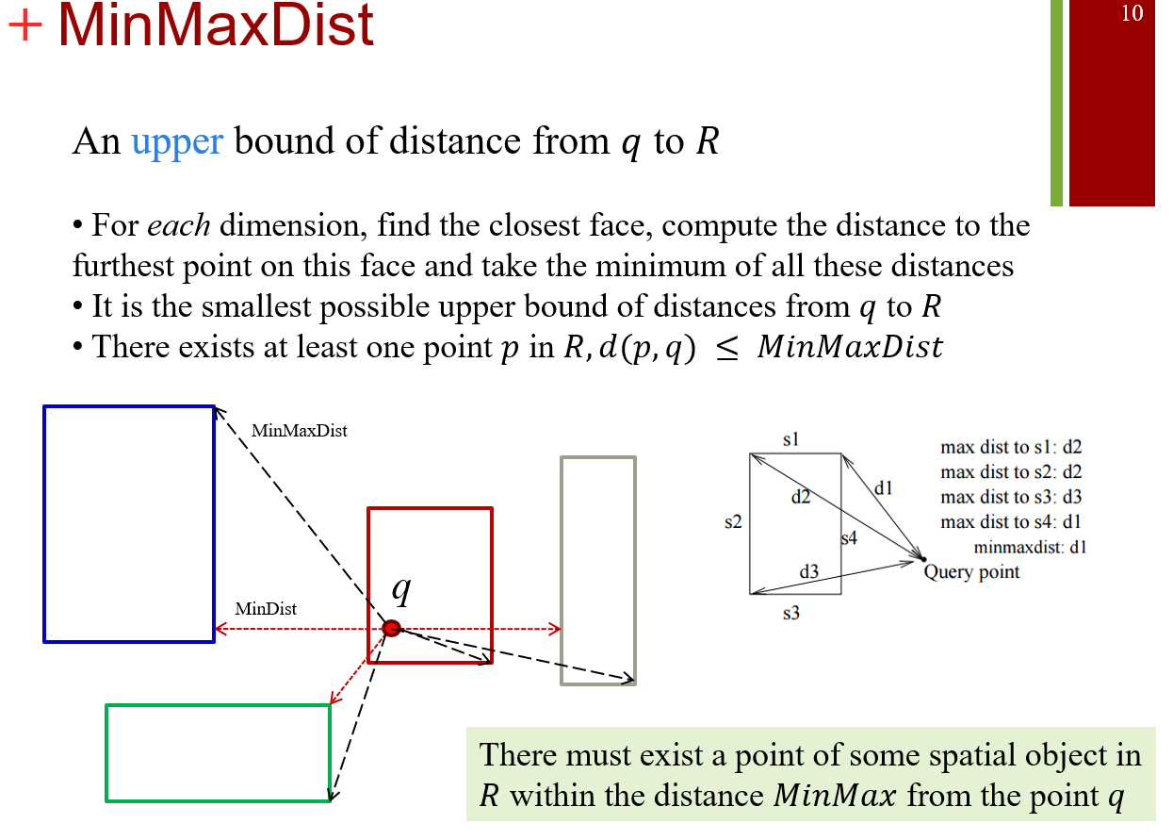

Slide 22
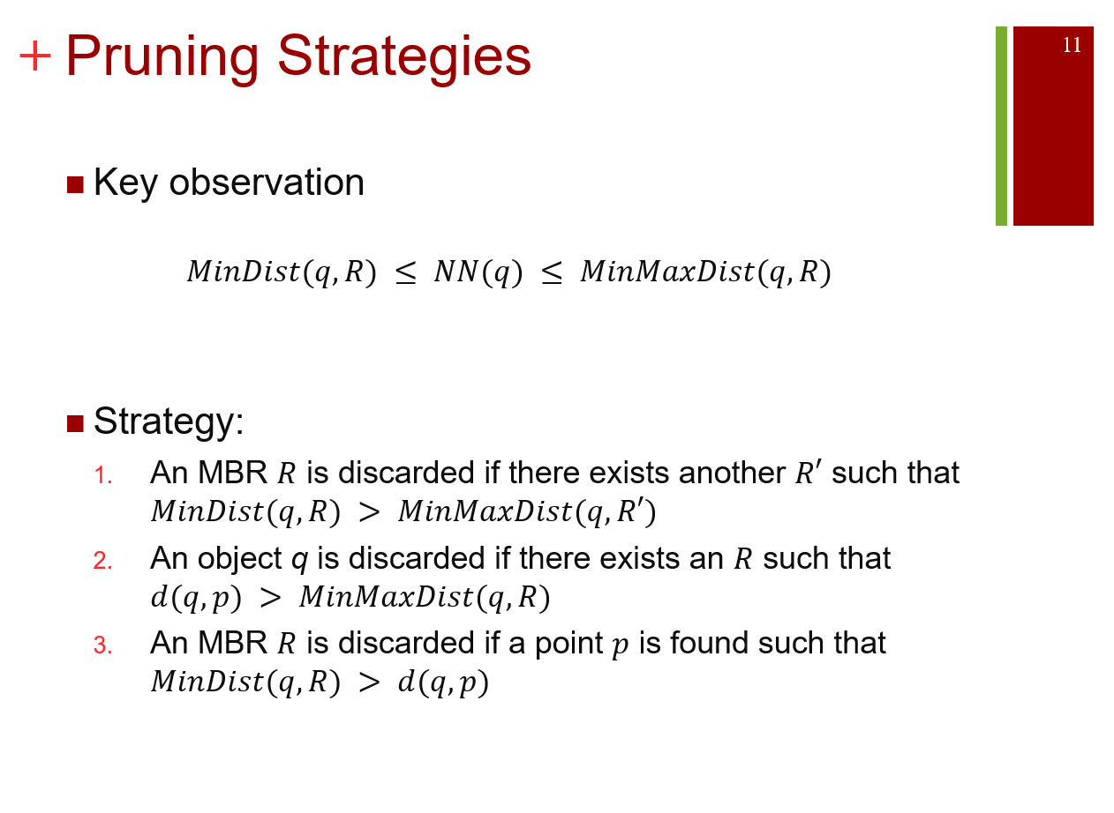

Slide 23
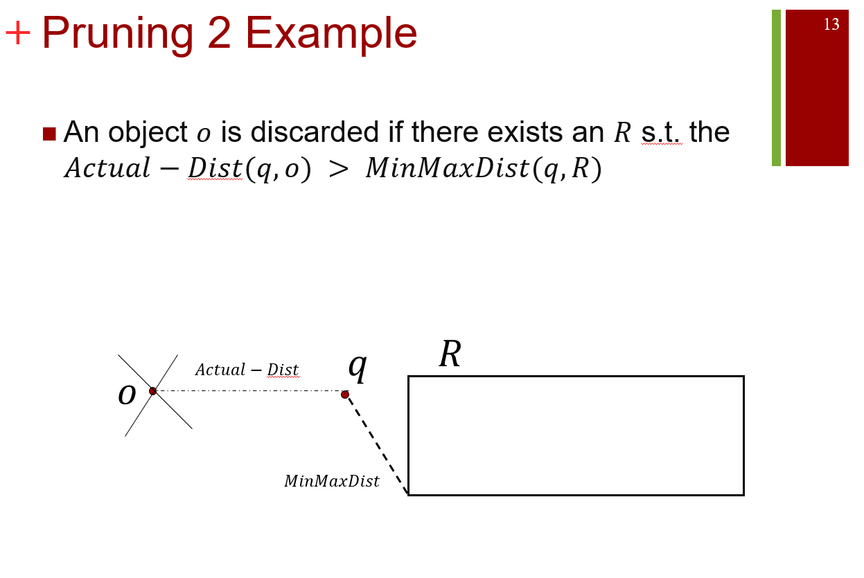

Slide 24
Q4
KNN BF: How to extend the Best-First Nearest Neighbor algorithm to answer the kNN query?

Slide 25
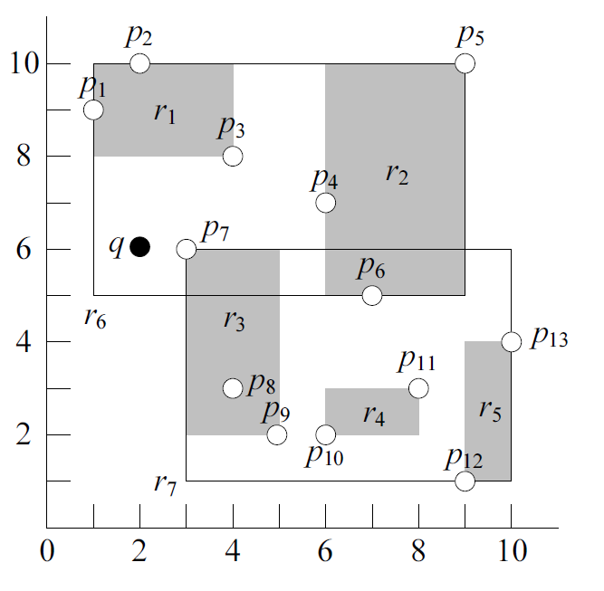
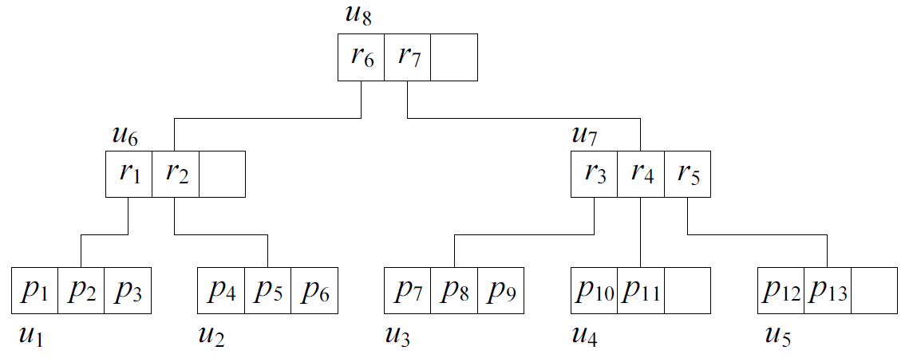


kNN Best First (BF)
$H$: A sorted list with $MinDist$ as key
Use a heap
$r_{6}$ and $r_{7}$
$MinDist\left(q,r_{6}\right)=0<MinDist\left(q,r_{7}\right)=1$
$$r_{6},0$$
$$r_{7},1$$

Slide 26
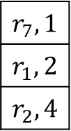
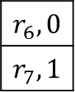

kNN Best First (BF)
Visit $u_{6}$
$r_{1}$ and $r_{2}$
$MinDist\left(q,r_{1}\right)=2$
$MinDist\left(q,r_{2}\right)=4$
$$r_{6},0$$
$$r_{7},1$$
$$r_{7},1$$
$$r_{1},2$$
$$r_{2},4$$

Slide 27
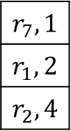
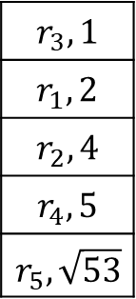

kNN Best First (BF)
Visit $u_{7}$
$r_{3},r_{4}$ and $r_{5}$
$d\left(q,r_{3}\right)=1$
$d\left(q,r_{4}\right)=5$
$d\left(q,r_{5}\right)=$ $\sqrt{53}$
$$r_{7},1$$
$$r_{1},2$$
$$r_{2},4$$
$$r_{3},1$$
$$r_{1},2$$
$$r_{2},4$$
$$r_{4},5$$
$$r_{5},\sqrt{53}$$

Slide 28
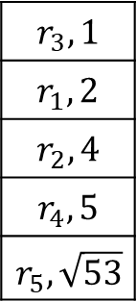
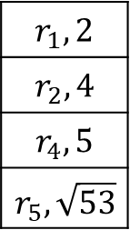

kNN Best First (BF)
Visit $u_{3}$
$p_{7},p_{8}$ and $p_{9}$
$d\left(q,p_{7} \right)=1$
$d\left(q,p_{8}\right)=\sqrt{13}$
$d\left(q,p_{9}\right)=$ $5$
1<2, $p_{7}$ is the nearest neighbour
$$r_{3},1$$
$$r_{1},2$$
$$r_{2},4$$
$$r_{4},5$$
$$r_{5},\sqrt{53}$$
$$r_{1},2$$
$$r_{2},4$$
$$r_{4},5$$
$$r_{5},\sqrt{53}$$

Slide 29

K-NN search
Just a simple extension
Keep the sorted buffer of at most $k$ current nearest neighbors
Pruning is done using the $k$-th distance

Slide 30
Q5
Skyline: Why the skyline result will appear in all monotonically increasing function-based NN results?

Slide 31

Monotonically Increasing Functions
Monotonically Increasing Functions
Let $p$ be a $d$-dimensional point in $ℝ^{d}$
Let $f$ : $ℝ^{d}→R$ a function that calculates a score $f(p)$ for $p$
We say that $f$ is monotonically increasing if the score increases when any coordinate of $p$ increases.

Slide 32
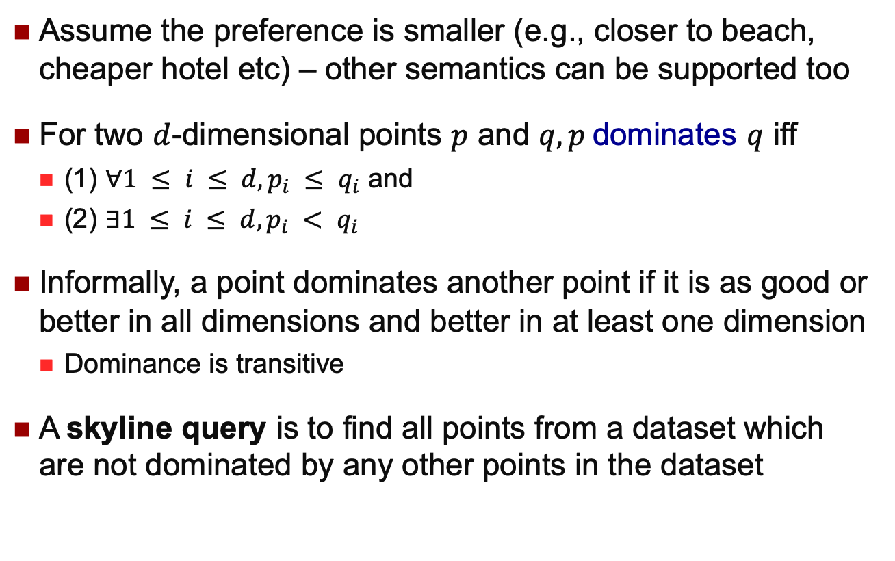
A Formal Definition
Assume the preference is smaller (e.g., closer to beach, cheaper hotel etc) – other semantics can be supported too
For two $d$-dimensional points $p$ and $q, p$dominates $q$ iff
(1) $∀1 ≤ i ≤ d, p_{i} ≤ q_{i}$ and
(2) $∃1 ≤ i ≤ d, p_{i} < q_{i}$
Informally, a point dominates another point if it is as good or better in all dimensions and better in at least one dimension
Dominance is transitive
A skyline query is to find all points from a dataset which are not dominated by any other points in the dataset
…Pareto dominance

Slide 33
Finding a Hotel…
distance
t₂, t₃ and t₄ are dominated.
t₂
t₄
t₃
t₇
1 2 3 4 5 6 7 8
t₅
t₁
t₆
1 2 3 4 5 6 7 8 9
price
Skyline query: retrieve all points that are not dominated

Slide 34
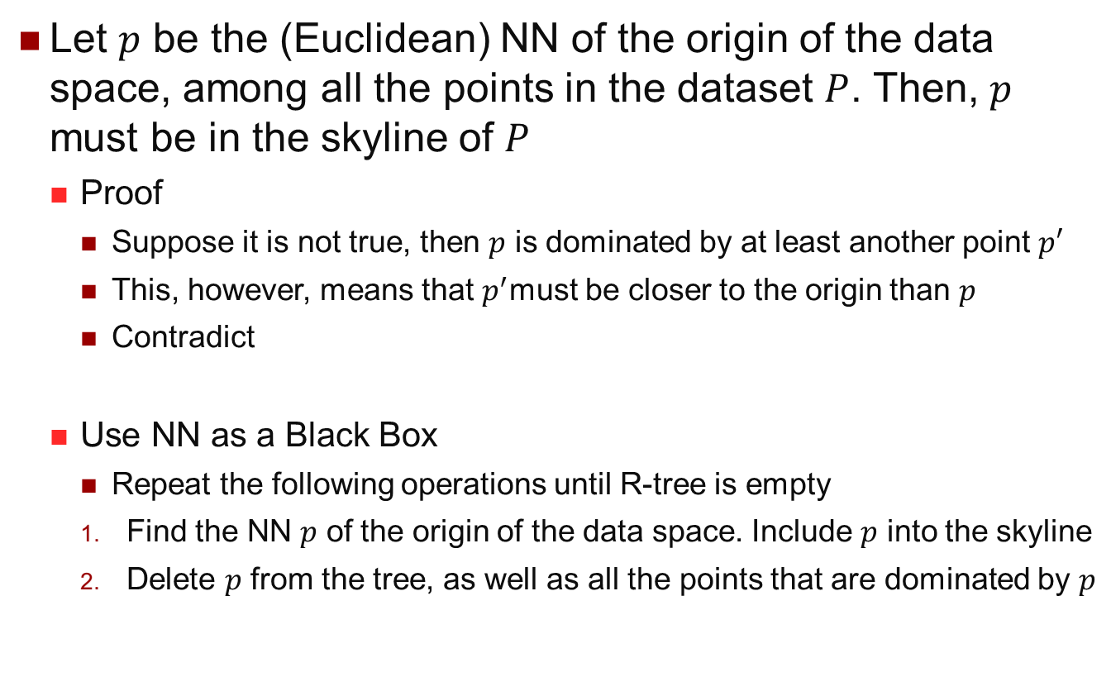
Skyline with NN
Let $p$ be the (Euclidean) NN of the origin of the data space, among all the points in the dataset $P$. Then, $p$ must be in the skyline of $P$
Proof
Suppose it is not true, then $p$ is dominated by at least another point $p′$
This, however, means that $p^{′}$must be closer to the origin than $p$
Contradict
Use NN as a Black Box
Repeat the following operations until R-tree is empty
Find the NN $p$ of the origin of the data space. Include $p$ into the skyline
Delete $p$ from the tree, as well as all the points that are dominated by $p$

Slide 35
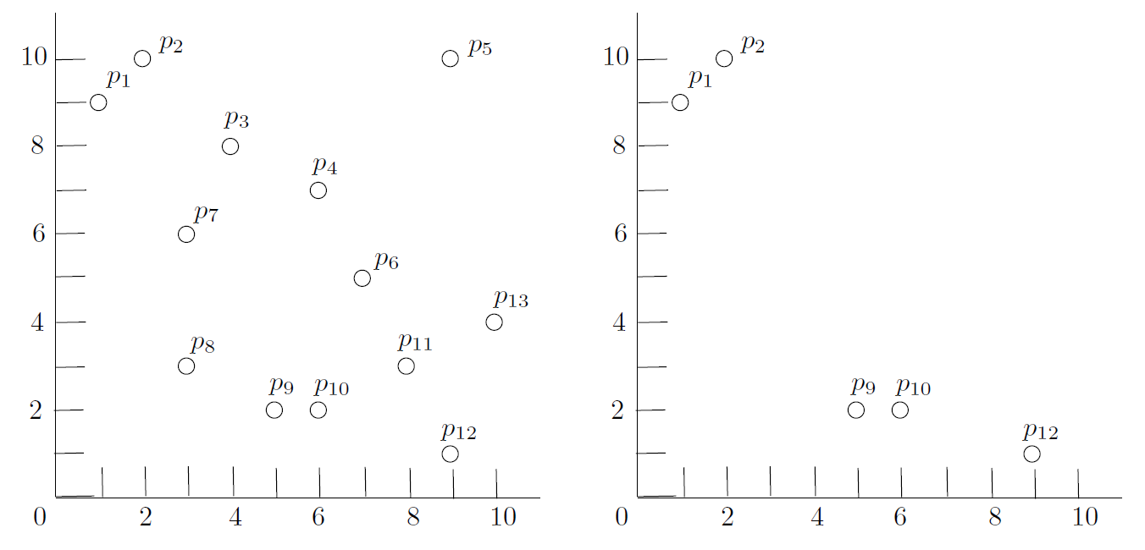

Skyline with NN Example
The first NN query finds $p_{8}$
The figure on the right shows the dataset after the corresponding deletions

Slide 36
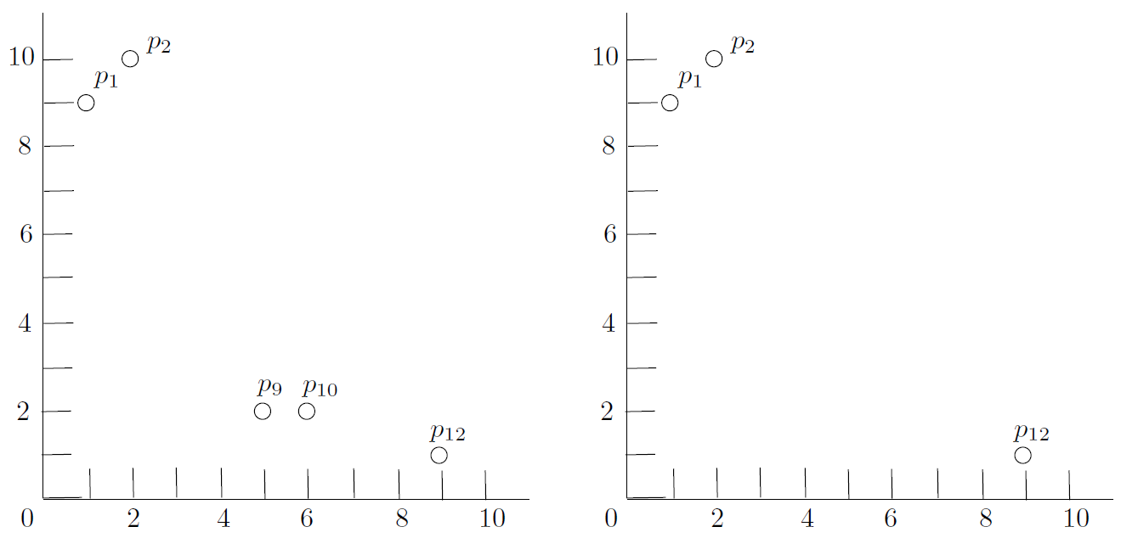

Skyline with NN Example
The second NN query finds $p_{9}$
The figure on the right shows the dataset after the corresponding deletions

Slide 37
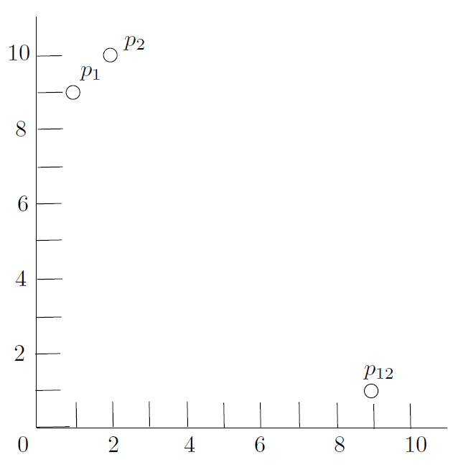
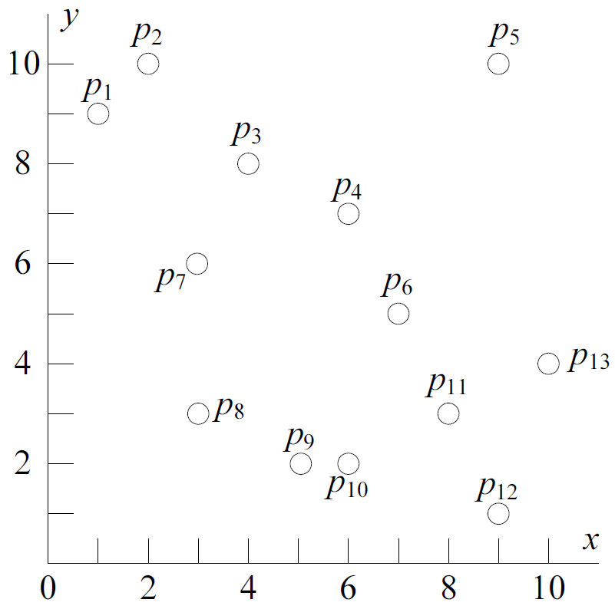

Skyline with NN Example
The third NN query finds $p_{1}$ and $p_{12}$
The dataset becomes empty after corresponding deletions
Final skyline points=$\{p_{8},p_{9},p_{1},p_{12}\}$

